Slide 1
SWAN (K18X001.00) Cross section Test overview
Prepare: JBD-VN-ME
Date: 2022.08.18

Slide 2
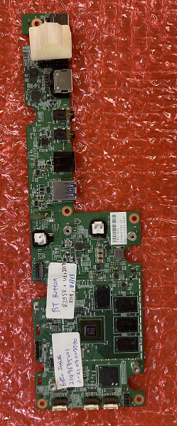
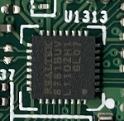
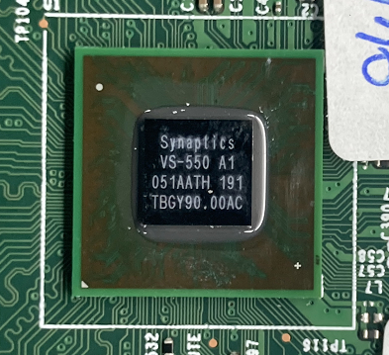
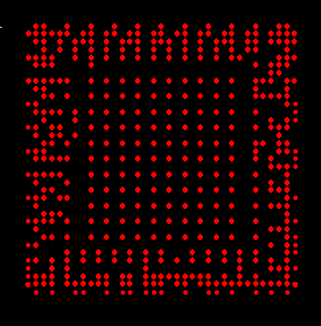

1.PCBA Cross Section Map
A. Location of cross section experiment with PCBA:
U1313
ROW1
ROW2
ROW4
ROW3
U1
ROW 1
ROW 2
ROW 3
Based on the diagram and conduct cross section experiment with positions U1 & U1313.

Slide 3
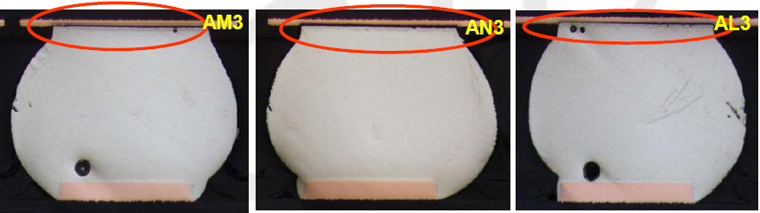
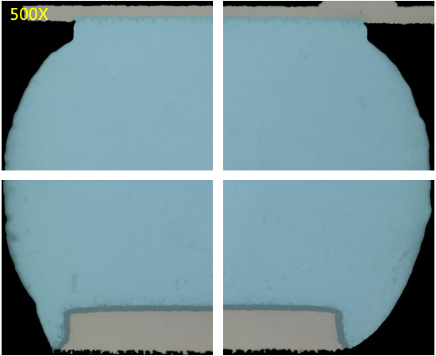
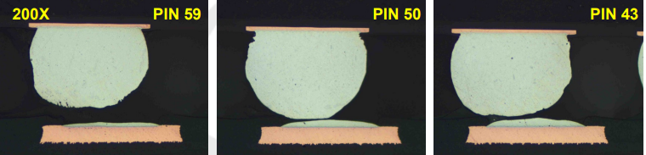
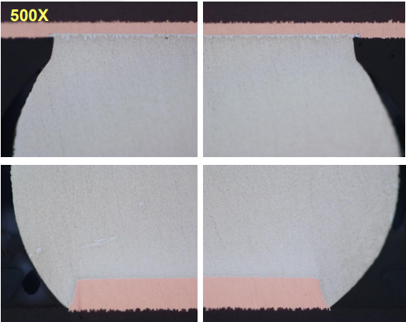
1.PCBA Cross Section Map
B. Contrast image between Sample Pass and Fail:
Fail
Pass
PCBA Comparison image of the cross section experiment with component.

Slide 4
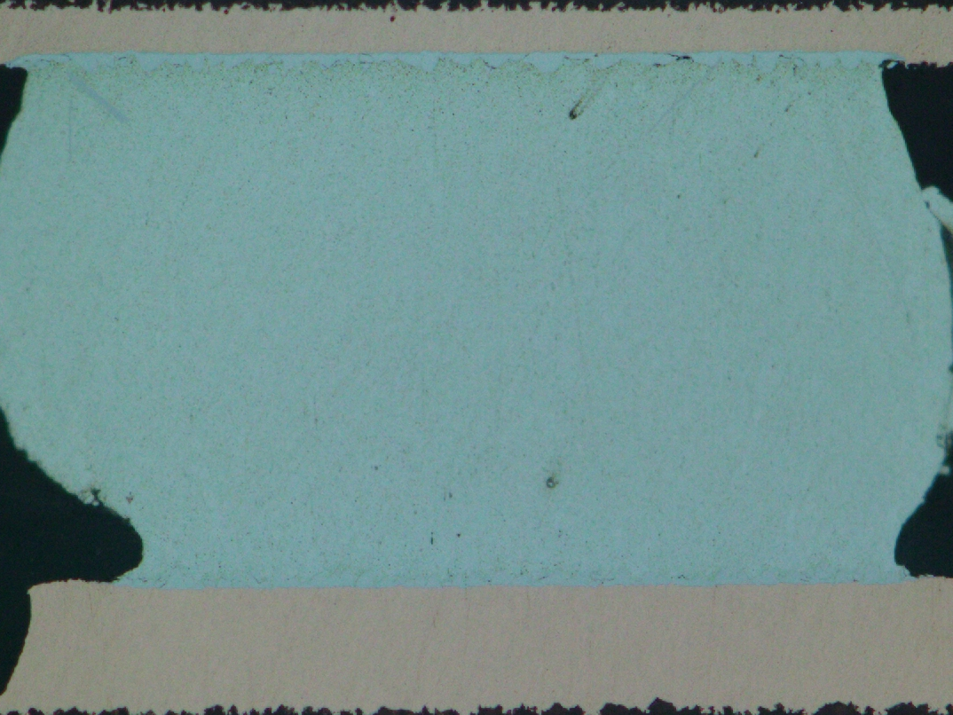
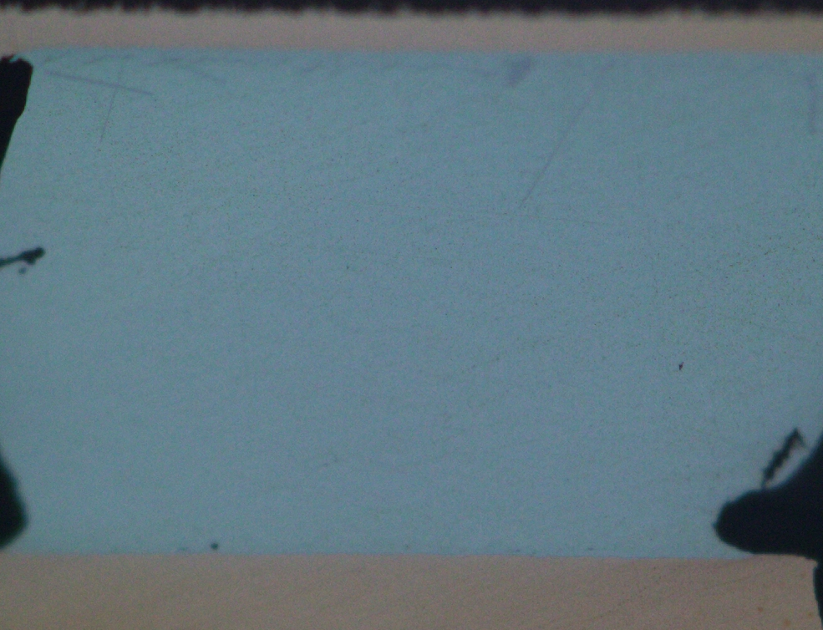
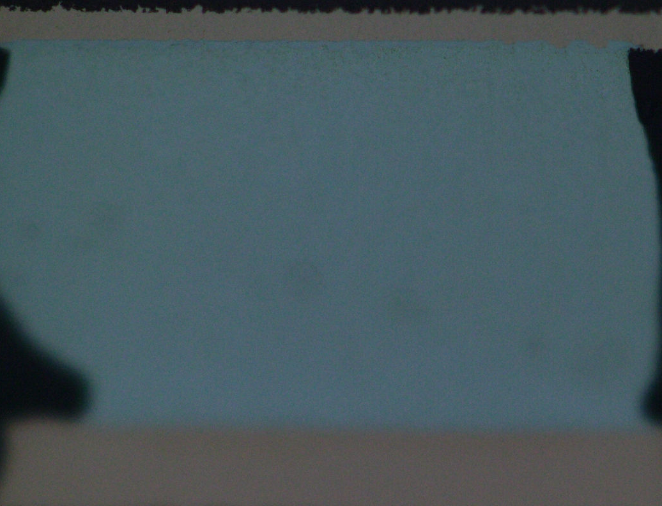
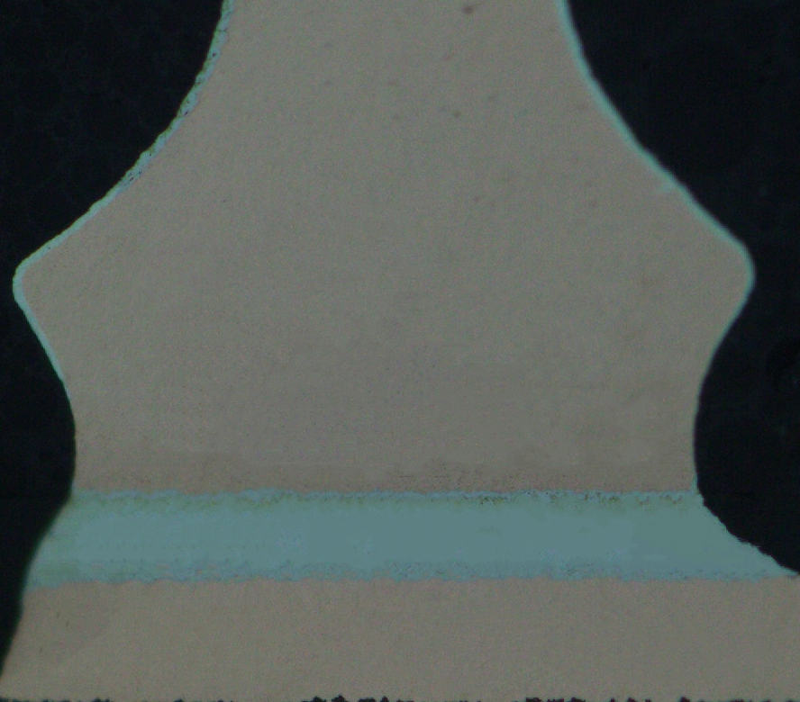
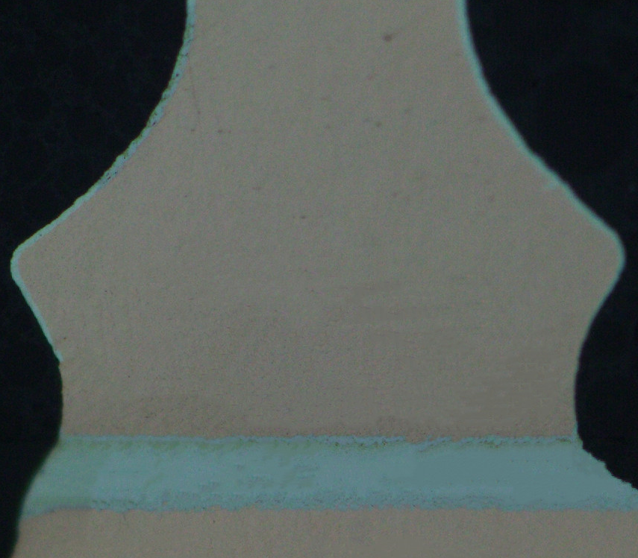
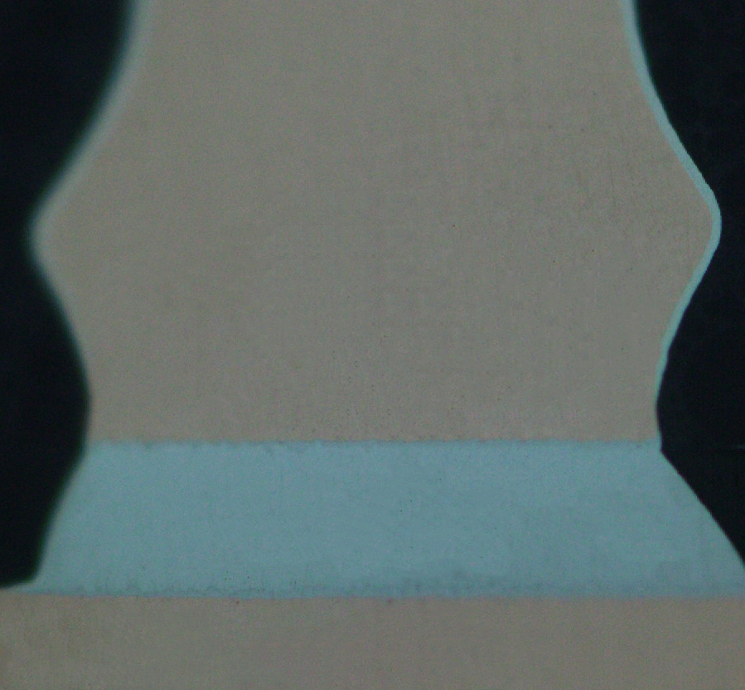
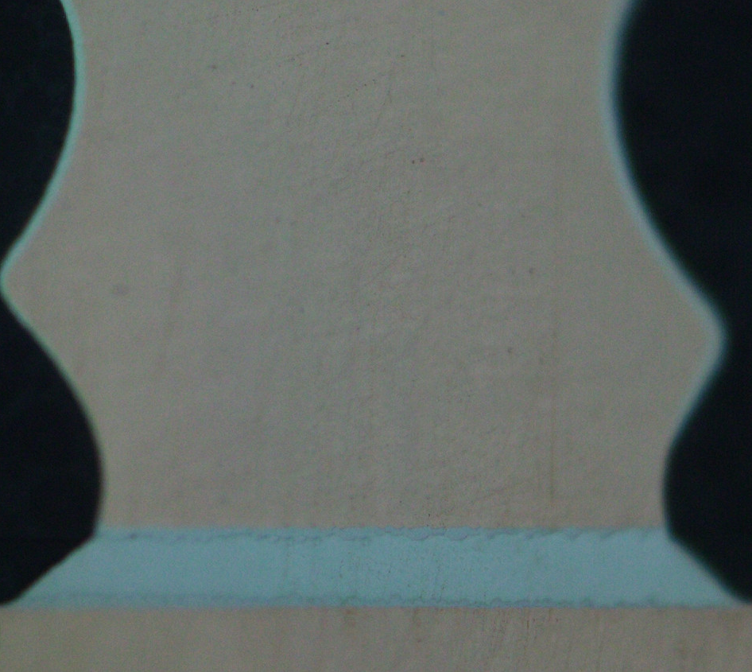
1.PCBA Cross Section Map
C. BGA (U1) &QFN (U1313) image-Magnify*500x
Checking the cross section position of the component did not find any abnormality

Slide 5
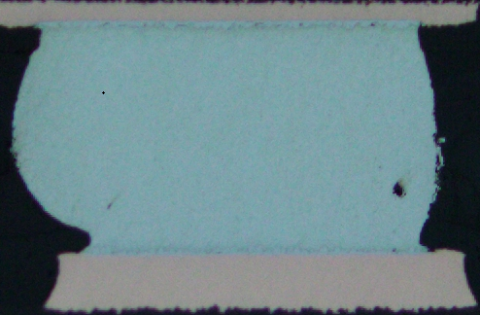
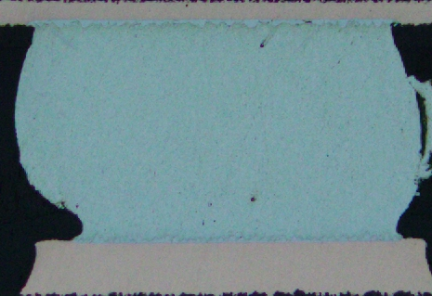
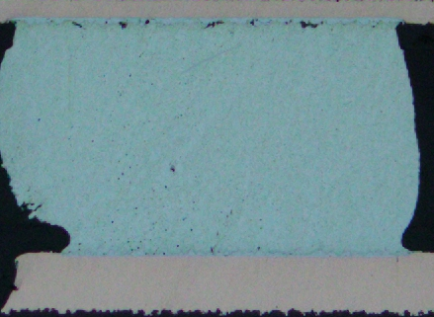
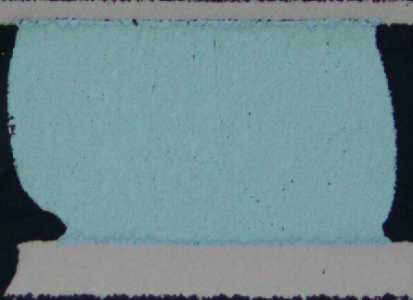
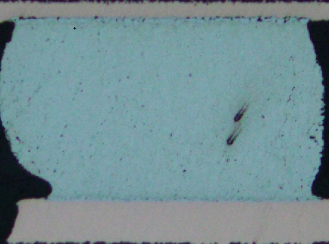
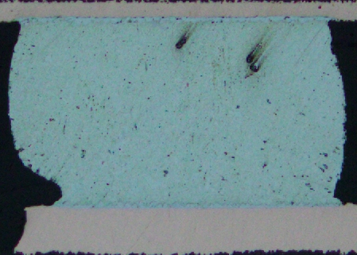
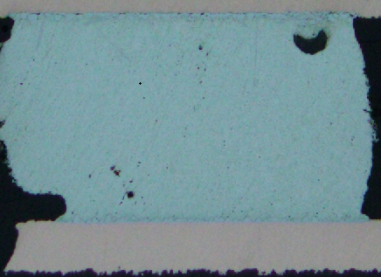
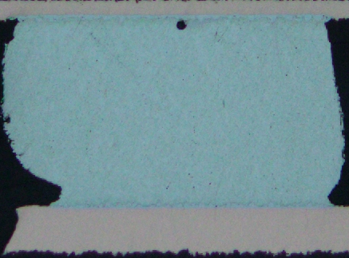
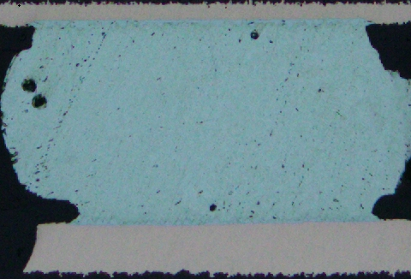
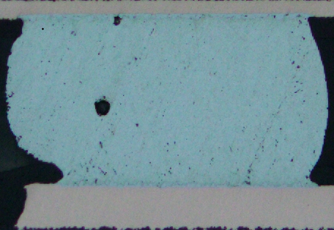
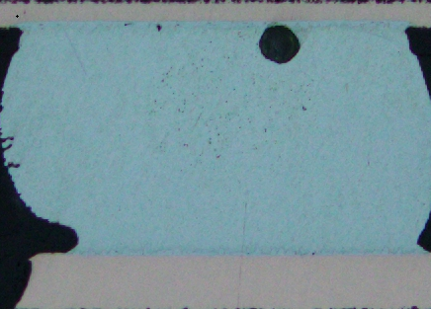
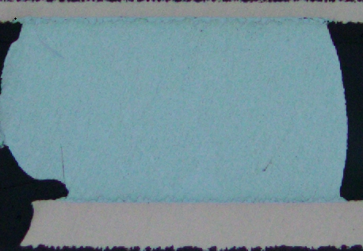
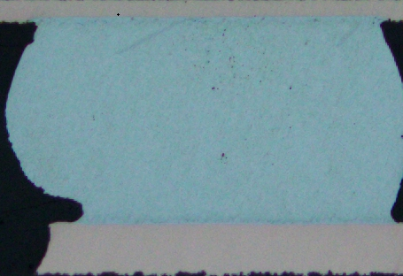
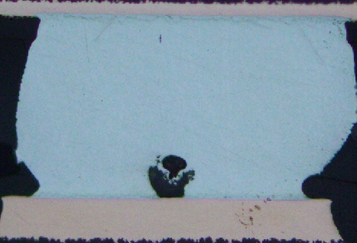
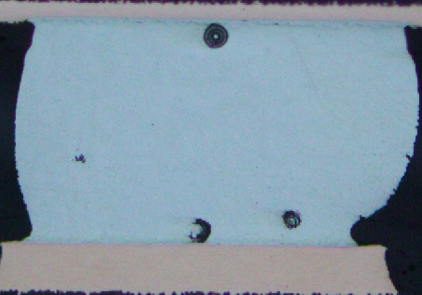
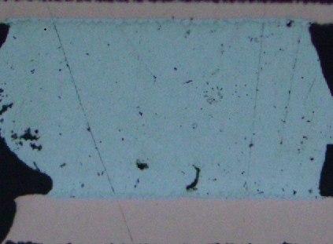
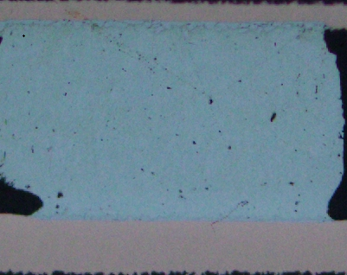
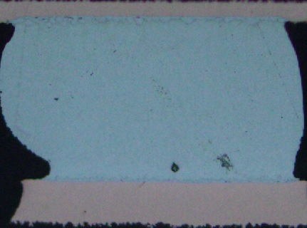
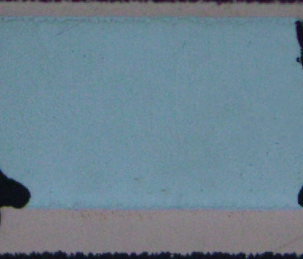
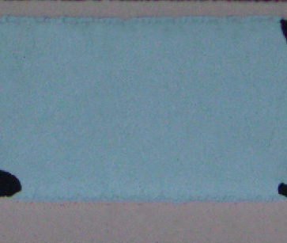
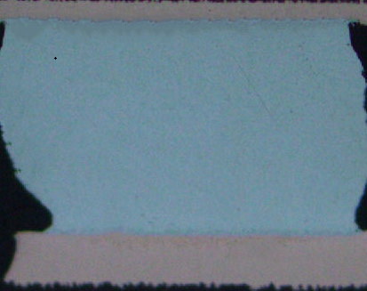
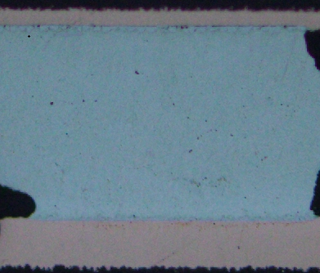
2. PCBA Cross Section location images on locations
A. Location U1 (BGA)-Magnify*200x:
Row-1
1# | 2# | 3# | 4# | 5# | 6# | 7# | 8# | 9# | 10# | 11#
12# | 13# | 14# | 15# | 16# | 17# | 18# | 19# | 20# | 21# | 22#
Detailed image of cross section experiment at position U1 (BGA)-No Crack

Slide 6
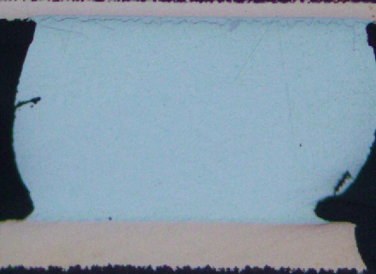
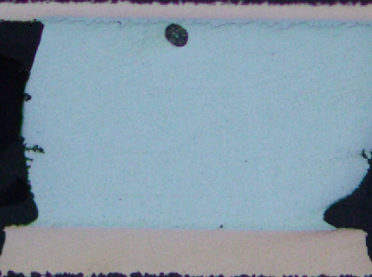
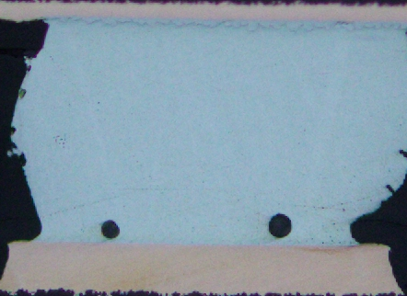
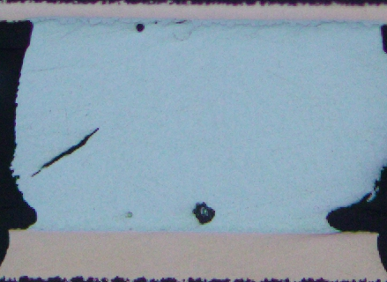
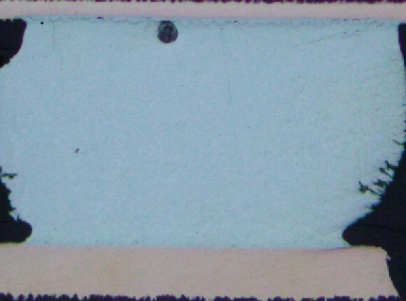
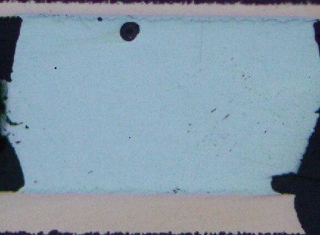
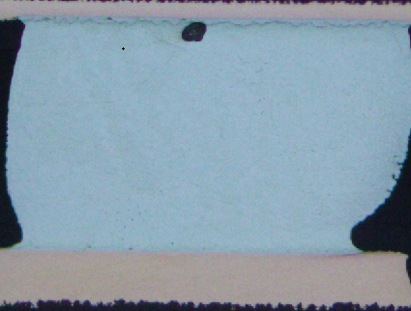
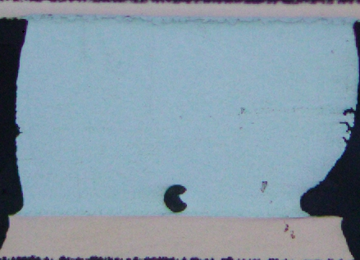
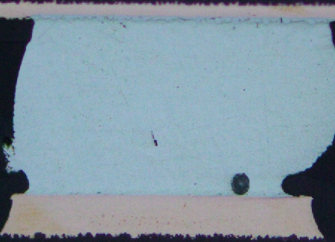
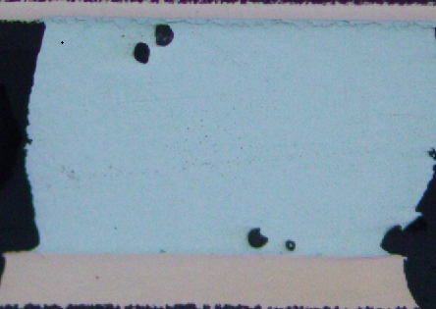
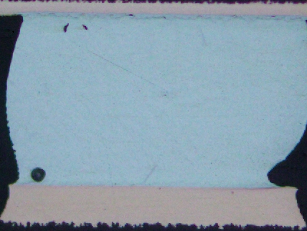
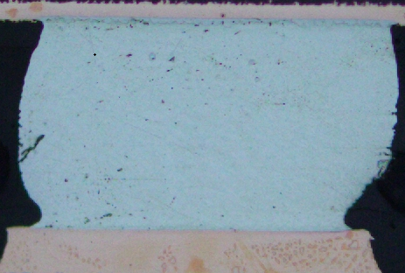
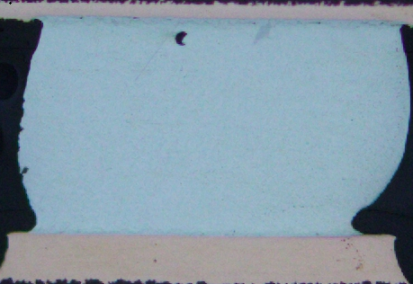


2. PCBA Cross Section location images on locations
A. Location U1 (BGA):
Row-2
1# | 2# | 3# | 4# | 5# | 6# | 7# | 8#
9# | 10# | 11# | 12# | 13# | 14# | 15# | NA
Detailed image of cross section experiment at position U1 (BGA)-No Crack

Slide 7























2. PCBA Cross Section location images on locations
A. Location U1 (BGA):
Row-3
1# | 2# | 3# | 4# | 5# | 6# | 7# | 8# | 9# | 10# | 11# | 12#
13# | 14# | 15# | 16# | 17# | 18# | 19# | 20# | 21# | 22# | 23# | NA
Detailed image of cross section experiment at position U1 (BGA)-No Crack

Slide 8
















2. PCBA Cross Section location images on locations
B. Location U1313 (QFN)- magnify*200x :
Row-1 & Row-2
Row-1 | 1# | 2# | 3# | 4# | 5# | 6# | 7# | 8#
Row-2 | 1# | 2# | 3# | 4# | 5# | 6# | 7# | 8#
Detailed image of cross section experiment at position U1313 (QFN)-No crack

Slide 9
















2. PCBA Cross Section location images on locations
B. Location U1313 (QFN):
Row-3 & Row-4
Row-3 | 1# | 2# | 3# | 4# | 5# | 6# | 7# | 8#
Row-4 | 1# | 2# | 3# | 4# | 5# | 6# | 7# | 8#
Detailed image of cross section experiment at position U1313 (QFN)-No crack

Slide 10
Thank you.

